Slide 1
Unit 2. Class Implementation
封装性
2.1 Implementing Classes
2.2 Inheritance
2.3 Polymorphism
2.4 Generic type
2.5 Collections
2.6 Abstract class
2.7 Interface
继承性
多态性
一对多关联关系的实现
基类的重新考虑
machunyan
西北工业大学软件与微电子学院

Slide 2
2.3 Polymorphism
The term polymorphism is defined in Merriam-Webster’s dictionary as “the quality or state of being able to assume different forms.”
In an Object-Oriented Programming Language, polymorphism is One Distinguishing Feature.
    Polymorphic variable
    Polymorphic method call
    Discussion
machunyan
西北工业大学软件与微电子学院

Slide 3

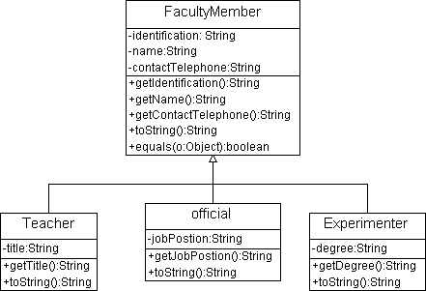



1. Polymorphic variable
FacultyMemeber m;
Polymorphic variable
machunyan
西北工业大学软件与微电子学院

Slide 4
2.3 Polymorphism
2. Polymorphic method call
FacultyMemeber m;
m.toString ();
Polymorphic method call
machunyan
西北工业大学软件与微电子学院

Slide 5
2. Polymorphic method call (cont)
The line of code m.printInfo( ) said to be polymorphic because the logic performed in response to the same method call can take many different forms, depending on the class identity of the object at run time.
machunyan
西北工业大学软件与微电子学院

Slide 6
2. Polymorphic method call (cont)
How Polymorphism Works Behind the Scenes (Static vs. Dynamic Binding)
  Static Binding----compile-time
    FacultyMember m；
machunyan
西北工业大学软件与微电子学院

Slide 7
2. Polymorphic method call (cont)
How Polymorphism Works Behind the Scenes (Static vs. Dynamic Binding)
  Dynamic Binding---run-time
    Java Virtual Machine (JVM) determines which version of the method to execute by examining the reference variable (polymorphic variable) used in the method call.
machunyan
西北工业大学软件与微电子学院

Slide 8
3. Discussion
Polymorphic variable allows
  many types (derived from the same base type) to be treated as if they were one type, and a single piece of code to work on all those different types equally.
    For example FacultyDemo.java
machunyan
西北工业大学软件与微电子学院

Slide 9
3. Discussion (cont.)
polymorphic method call allows
  one type to express its distinction from another, similar type, as long as they’re both derived from the same base type.
  For example FacultyDemo.java
machunyan
西北工业大学软件与微电子学院

Slide 10
2.3 Polymorphism
3. Discussion (cont.)
Class diagram designing
  The design solution of Software College Management System (SCMS )
      One class Associates with all subclasses of some base class-------> One class Associates with the base class
machunyan
西北工业大学软件与微电子学院

Slide 11
3. Discussion (cont.)
Polymorphism Simplifies Code Maintenance
  Polymorphism can make our code much more concise.
    If the programming language doesn’t support polymorphism
      We have to do with a variety of different kinds of faculty members using a series of if tests.
      For example
machunyan
西北工业大学软件与微电子学院

Slide 12
3. Discussion (cont.)
Polymorphism Simplifies Code Maintenance
  Better still, polymorphic client code is robust to change.
  For example, long after our SCMS application has been coded, tested, and deployed, we derive classes called Administrator and DeanOfficial from official, each of which in turn overrides the printInfo method of official to provide its own “flavor” of print functionality. We’re now free to randomly insert Administrators and DeanOfficials into our Faculty collection, our polymorphic code for iterating through the collection doesn’t have to change!
machunyan
西北工业大学软件与微电子学院

